Slide 1
File Systems
Week 9

Slide 2
Files
A file is a named collection of data handled as a unit: a photo, a song, an essay, a program
Files live on secondary storage, which keeps data when the power is off (more in the Storage, I/O, and Backups week)
The OS gives you a way to find and organize files: File Explorer, Finder, or the Linux command line
  File systems protect data from corruption, or from loss after a crash
  Large amounts of shared data, like a store's inventory, often go in a database instead
Notes:
Wikipedia, File system: https://en.wikipedia.org/wiki/File_system

Slide 3
Bits, Bytes, and Files
Bit: a single 1 or 0, the smallest piece of data
Byte: 8 bits, enough for one basic character like the letter A
Character: a byte or group of bytes that stands for a letter, number, symbol, or emoji (next slide)
A file is a sequence of bytes
  A text file's bytes are characters you can read
  A photo's bytes are compressed image data that a photo app turns back into a picture
  The program that opens the file decides what the bytes mean

Slide 4
Character Sets
Unicode: the standard today, covering almost every writing system plus emoji
UTF-8: the most common way to store Unicode, used by about 99% of websites
ASCII: the original 128 English characters. Plain ASCII text is also valid UTF-8
Historical note: EBCDIC is an older IBM character set
  Still worth knowing because IBM mainframes in banks and government still use it, and data moved off them has to be converted
Notes:
W3Techs character encodings: https://w3techs.com/technologies/overview/character_encoding
IBM, The EBCDIC character set: https://www.ibm.com/docs/en/zos-basic-skills?topic=mainframe-ebcdic-character-set

Slide 5
File Systems
Organize files and manage access to data
Keep track of where each file's data is stored, and which space is free
Device independence: use names like /home/sam/essay.docx, not device names like /dev/nvme0n1
Protect files with permissions, so only the right people can use them
Help recover after a crash (journaling, later in this deck)
Encryption, so data is only useful to the people it's meant for
  Full-disk encryption: LUKS (Linux), BitLocker (Windows), FileVault (macOS)
  A stolen laptop can't be read without the password or key

Slide 6
Directories
Directories (folders) hold the names and locations of other files
A directory entry stores: name, location, size, type, last accessed, and modified and creation times
Folders inside folders make a tree (next slides)

Slide 7
Hierarchical File System
The simplest design, a flat file system, keeps every file in one directory, so no two files can share a name
A hierarchical file system fixes this with a tree of directories
  A root directory at the top points to other directories
  File names only need to be unique within one directory
  A file's full name is its path from the root
Linux: one tree, starting at / (root)
Windows: each drive has its own tree with a letter, such as C:\

Slide 8
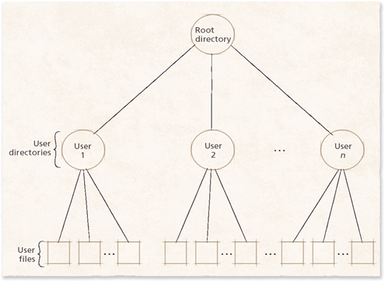
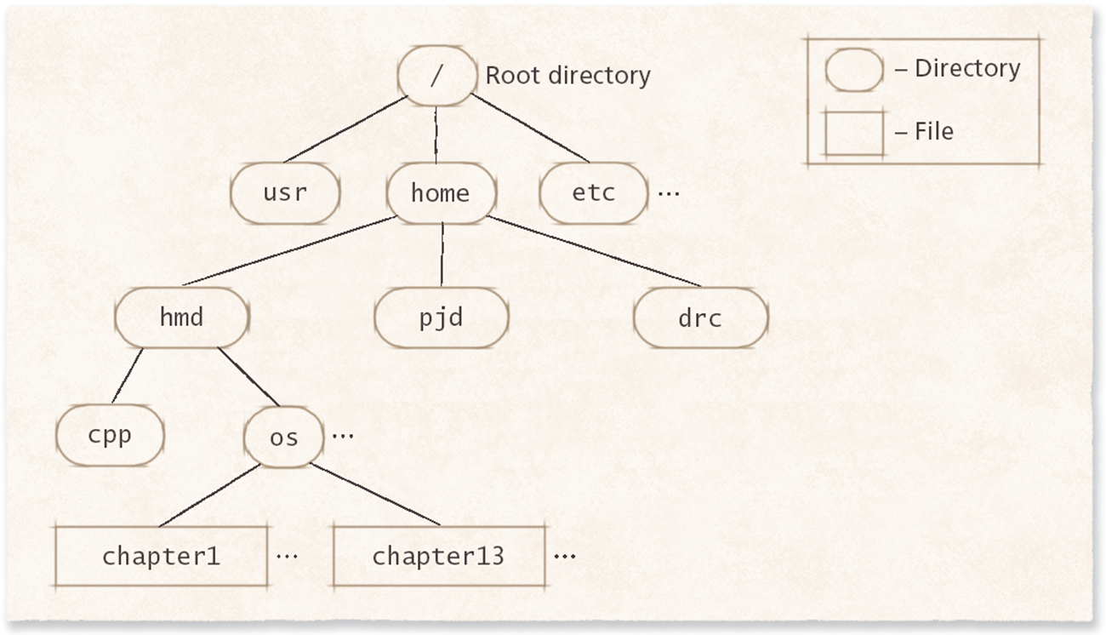
Hierarchical File System Example

Slide 9
Common Linux Directories
/home: each user's personal files
/etc: system settings (configuration files)
/var/log: log files
/tmp: temporary files
/dev: devices, such as drives. On Linux, almost everything is treated like a file
/media and /mnt: where USB drives and other storage get attached
Notes:
Linux manual page, hier: https://man7.org/linux/man-pages/man7/hier.7.html

Slide 10
Pathnames
Working directory: the directory you're in right now (pwd on Linux)
Absolute path: from the root to the file
  Linux: /home/sam/Documents/essay.docx
  Windows: C:\Users\sam\Documents\essay.docx (backslashes)
Relative path: starts from the working directory
  From /home/sam: Documents/essay.docx
  . means "this directory" and .. means "one directory up"
Two files can share a name if their absolute paths are different

Slide 11
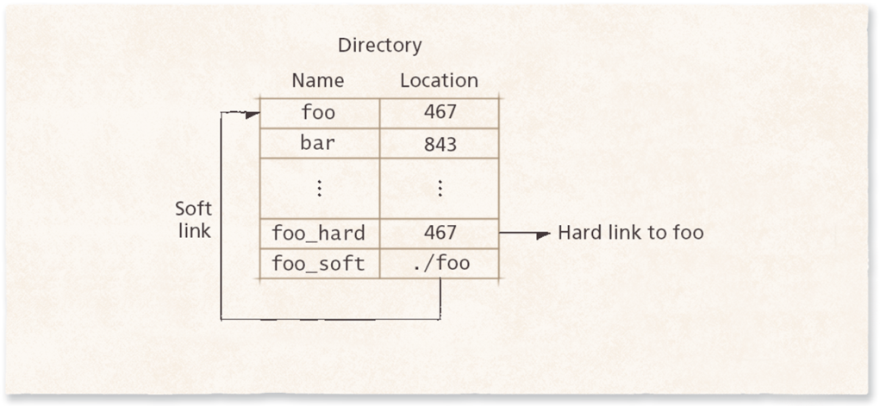
Soft Links and Hard Links
Soft link (symbolic link): a shortcut that stores the path to another file
  Breaks if the original is moved, renamed, or deleted
  Linux: ln -s. Windows shortcuts and macOS aliases work the same way
Hard link: a second name for the same file (same inode)
  Moving or renaming the other name doesn't break it
  Data is deleted only when every hard link is gone
  Can't cross file systems. Linux: ln
Notes:
Red Hat, Hard links and soft links in Linux explained: https://www.redhat.com/en/blog/linking-linux-explained
Linux manual page, symlink: https://man7.org/linux/man-pages/man7/symlink.7.html
Linux manual page, ln: https://man7.org/linux/man-pages/man1/ln.1.html

Slide 12
Metadata
Data about the data: name, size, owner, permissions, timestamps, and where the blocks are
  Users can't edit it directly. The OS updates it when you rename a file or change permissions
  On Linux it's stored in the file's inode. ls -l and stat show it
  Permissions are metadata too. ls -l shows them like -rw-r----- (more in Week 12, Security)
Superblock: critical information about the whole file system
  Such as the file system ID and where the free blocks are
  Extra copies are kept across the device in case one is damaged
Notes:
Linux manual page, inode: https://man7.org/linux/man-pages/man7/inode.7.html

Slide 13
Open Files
The OS keeps a list of which programs have which files open
  That's why Windows sometimes won't let you delete or rename a file: "the file is open in another program"
  Close the program, then try again
  Linux usually lets you delete it anyway. The data stays until the program closes the file
On Linux, lsof lists open files (lsof means "list open files")
Behind the scenes, the OS gives a program a number for each file it opens (a file descriptor), like a coat check ticket
Notes:
Linux manual page, lsof: https://man7.org/linux/man-pages/man8/lsof.8.html

Slide 14
Partitions and Formatting
A drive can be split into sections called partitions
  Each partition acts like its own drive
Formatting a partition puts a file system on it, and erases what was there
  When you format a USB drive, you pick one: FAT32, exFAT, or NTFS
The map of where each partition starts and ends (the partition table) is covered in the Storage, I/O, and Backups week
Notes:
Microsoft, UEFI/GPT-based hard drive partitions: https://learn.microsoft.com/en-us/windows-hardware/manufacture/desktop/configure-uefigpt-based-hard-drive-partitions

Slide 15
Mounting a File System
Mounting attaches a file system to a directory in the tree, so its files show up there
On Linux, a USB drive usually appears under /media/your-username/
The mount command shows what's mounted. /etc/fstab lists drives to mount at startup
Windows gives each drive a letter instead, such as D:
Notes:
Linux manual page, mount: https://man7.org/linux/man-pages/man8/mount.8.html

Slide 16
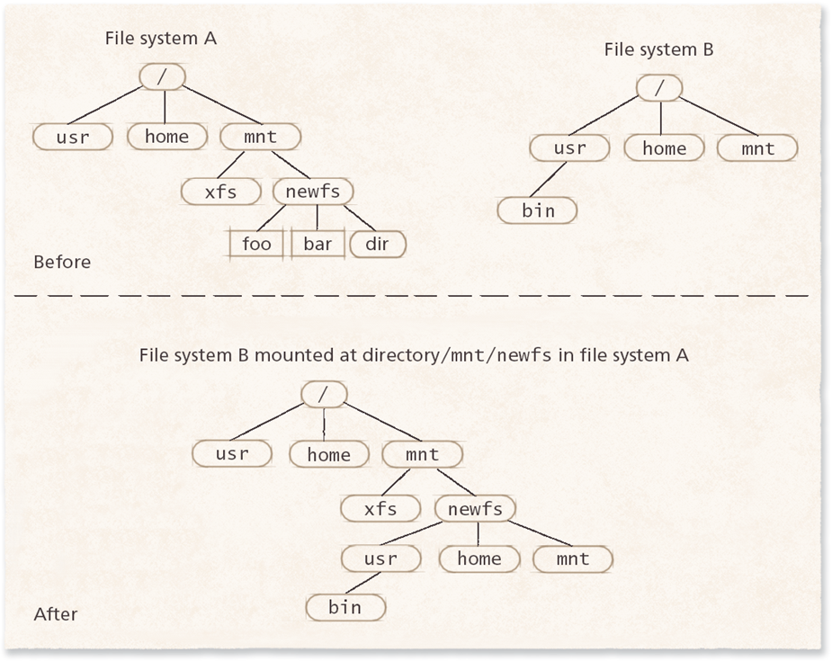
Mounting Example

Slide 17
Meet the File Systems
ext4 (fourth extended file system): the Linux default since 2008. Journaling, inodes, and extents
XFS: Red Hat Enterprise Linux's default, built for very large files and drives
Btrfs and ZFS: copy-on-write with built-in snapshots. Btrfs is Fedora's default, ZFS is popular on NAS boxes
NTFS (New Technology File System): Windows' default since XP. Journaling, permissions, and the Master File Table
APFS (Apple File System): Macs, iPhones, and iPads since 2017. Built for SSDs, with copy-on-write, snapshots, and encryption
FAT32 and exFAT: simple, and work on almost every device. Used on USB drives and SD cards
F2FS (Flash-Friendly File System): built for flash storage, used on many Android phones
Notes:
ext4: https://docs.kernel.org/filesystems/ext4/index.html
XFS: https://docs.kernel.org/admin-guide/xfs.html
Btrfs: https://btrfs.readthedocs.io/en/latest/Introduction.html
OpenZFS: https://openzfs.github.io/openzfs-docs/
NTFS: https://learn.microsoft.com/en-us/windows-server/storage/file-server/ntfs-overview
APFS: https://support.apple.com/guide/disk-utility/file-system-formats-dsku19ed921c/mac
F2FS: https://docs.kernel.org/filesystems/f2fs.html

Slide 18
File Allocation
Storage is split into small fixed-size chunks
  Sector: the drive's smallest piece
  Block: the file system's unit, often 4 KB. Windows calls it a cluster
  Extent: a run of blocks in a row
Handing out blocks is a lot like handing out main memory (Week 11)
Files grow and shrink, and users rarely know how big a file will be
Contiguous allocation has mostly been replaced by flexible noncontiguous allocation

Slide 19
Contiguous File Allocation
Put the whole file in one unbroken run of blocks
Advantage
  The parts of the file sit next to each other, so reading is fast
Disadvantages
  External fragmentation: free space breaks into gaps too small to use
  If a file grows and there's no room next to it, the whole file must move
Still used on read-only discs like DVDs, where files never grow

Slide 20
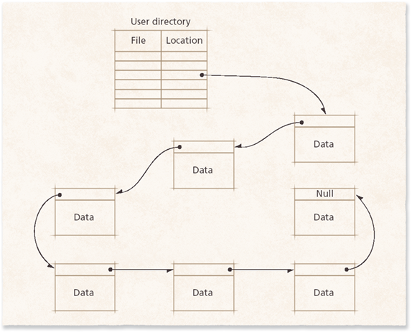
Linked-List Noncontiguous File Allocation
Each block holds data plus a pointer to the next block
  Like a scavenger hunt: each clue tells you where the next one is
To find something, follow the chain from the start, which can be slow
On a hard drive, each jump means moving the arm (a seek). SSDs don't have this problem
FAT, on the next slide, is this same idea with the pointers moved into one table

Slide 21
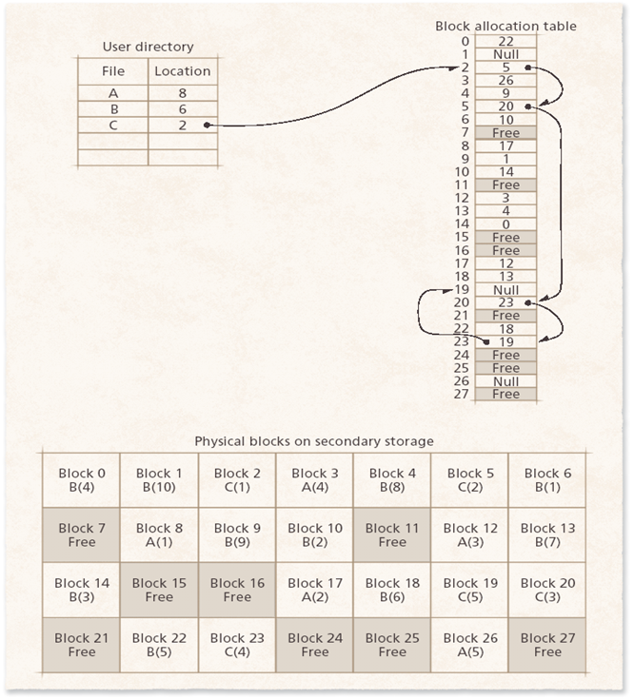
Tabular Noncontiguous File Allocation
Moves the "next block" pointers out of the blocks and into one table
The directory entry gives the first block, and the table gives each next block
The table can be kept in memory (cached), so following the chain is fast
But finding the end of a big file can mean following many pointers
Real example: Microsoft's FAT (File Allocation Table)

Slide 22
FAT Today
FAT32 and exFAT are still used on USB drives and SD cards
  Almost every device can read them: Windows, macOS, Linux, cameras, game consoles
FAT32 can't store a file bigger than 4 GB, so big videos need exFAT
The small partition your computer starts from (the EFI system partition) uses FAT32
Notes:
SD Association, SD card capacities (SDXC uses exFAT): https://www.sdcard.org/developers/sd-standard-overview/capacity-sd-sdhc-sdxc-sduc/
Microsoft, UEFI/GPT-based hard drive partitions: https://learn.microsoft.com/en-us/windows-hardware/manufacture/desktop/configure-uefigpt-based-hard-drive-partitions

Slide 23
Indexed Noncontiguous File Allocation
Each file has one or more index blocks
An index block lists pointers to the file's data blocks, like a table of contents
The directory entry points to the index block
The last entries can point to more index blocks (chaining)
Advantages over linked lists
  Search the index instead of the data
  Index blocks sit near their data, so reads are quick
Real examples: ext4 (inodes) and NTFS (the Master File Table)

Slide 24
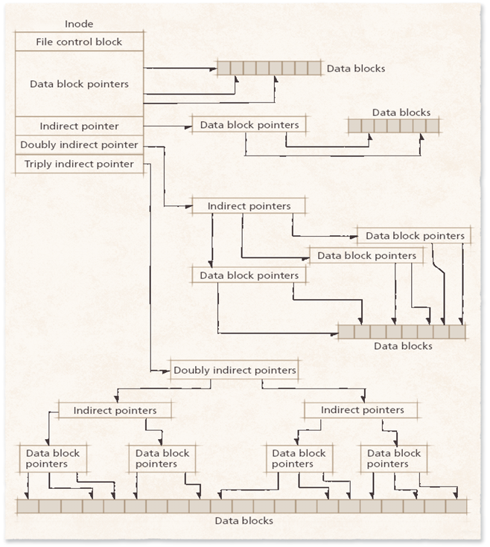
Index Block Chaining
Index blocks are called inodes (index nodes) in Unix and Linux
The picture shows the classic Unix inode: direct pointers, plus indirect pointers for big files
ext4 uses extents instead, so one pointer covers a whole run of neighboring blocks
Notes:
Linux kernel documentation, ext4: https://docs.kernel.org/filesystems/ext4/index.html

Slide 25
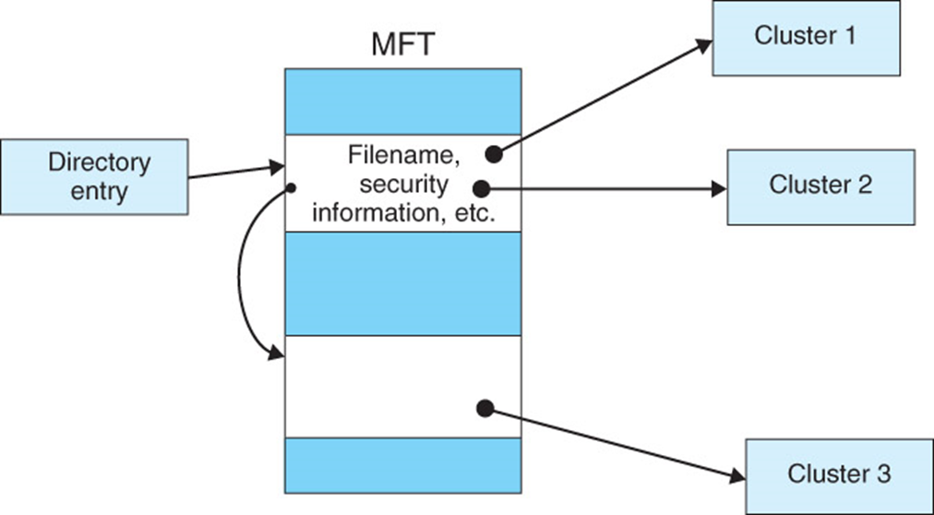
Windows NTFS File System
New Technology File System, from Windows NT (1993). Still the default on Windows 11
Master File Table (MFT): a record for every file, with its name, permissions, and where its data is
Journaling, permissions, encryption, and compression
Macs can read NTFS drives but can't write to them without extra software, so USB drives usually use exFAT
Notes:
Microsoft, NTFS overview: https://learn.microsoft.com/en-us/windows-server/storage/file-server/ntfs-overview

Slide 26
Tracking Free Space
The file system must always know which blocks are free
Free list: a linked list of the free blocks
  Low overhead, but files end up in scattered blocks
Bitmap: one bit for each block. 1 means used, 0 means free
  Quickly shows if neighboring blocks are free, but may need a long search to find one
  ext4 uses bitmaps to track free blocks and inodes

Slide 27
Crashing in the Middle of a Save
If the power goes out halfway through saving, data can be left half-written (inconsistent)
Atomic transactions: do a group of steps completely or not at all
  Like a bank transfer: money must leave one account and arrive in the other, never just one
  If a transaction can't finish, it's rolled back to how things were before
Checkpoints: mark the last point where everything was safely saved
  After a crash, the system only has to check what happened after the checkpoint
Databases rely on these same ideas

Slide 28
How File Systems Survive Crashes
Journaling file systems
  Write a note in the journal about what's going to change, then change it
  After a crash, read the journal to finish or undo changes, instead of checking the whole drive
  ext4, XFS, NTFS
Copy-on-write file systems
  Never overwrite in place: write the new version somewhere free, then switch the pointer
  Makes snapshots fast and cheap
  Btrfs, ZFS, APFS, ReFS
Log-structured file systems always write new data at the end, like a diary. F2FS on Android phones works this way, which suits flash storage
Notes:
Linux kernel documentation, the ext4 journal: https://docs.kernel.org/filesystems/ext4/journal.html
Btrfs documentation, Introduction: https://btrfs.readthedocs.io/en/latest/Introduction.html
Linux kernel documentation, F2FS: https://docs.kernel.org/filesystems/f2fs.html

Slide 29
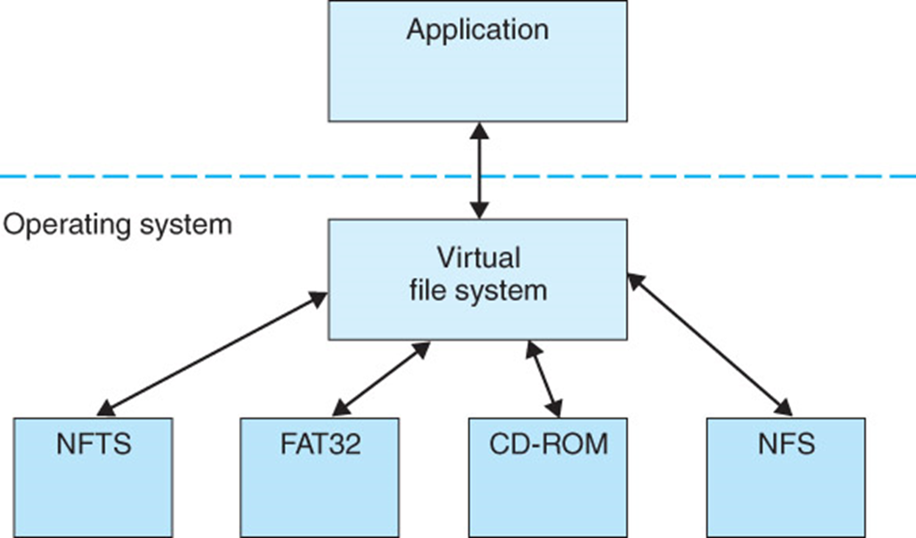
Multiple File System Types
Each partition has a single file system
One computer can use several types at once, such as ext4 for the main drive and exFAT for a USB drive
A Virtual File System (VFS) gives programs one way to open, read, and save files, whatever is underneath
Application
such as a text editor
Virtual File System (VFS)
part of the operating system
ext4
main drive
exFAT
USB drive
NFS
network share
proc
/proc system info
Notes:
Diagram: an application talks to the Virtual File System in the operating system, which talks to four different file systems: ext4 on the main drive, exFAT on a USB drive, NFS for a network share, and proc, which shows system information as files in /proc.
Linux kernel documentation, Overview of the Linux Virtual File System: https://docs.kernel.org/filesystems/vfs.html

Slide 30
File Servers and Distributed Systems
A file server: one computer dedicated to storing and sharing files
  Keeps control in one place, but can become a bottleneck
Common ways to share files today:
  NFS: the Linux and Unix way
  SMB: the Windows way. Linux uses Samba to talk SMB
  NAS (network-attached storage): a small file server for a home or office
  Cloud storage and sync: OneDrive, Google Drive, Dropbox
Very large systems spread files across many computers that talk directly to each other (Week 14)
Notes:
Ubuntu Server documentation, NFS: https://ubuntu.com/server/docs/how-to/networking/install-nfs/
Microsoft, What is SMB file sharing?: https://learn.microsoft.com/en-us/windows-server/storage/file-server/file-server-smb-overview

